Slide 1
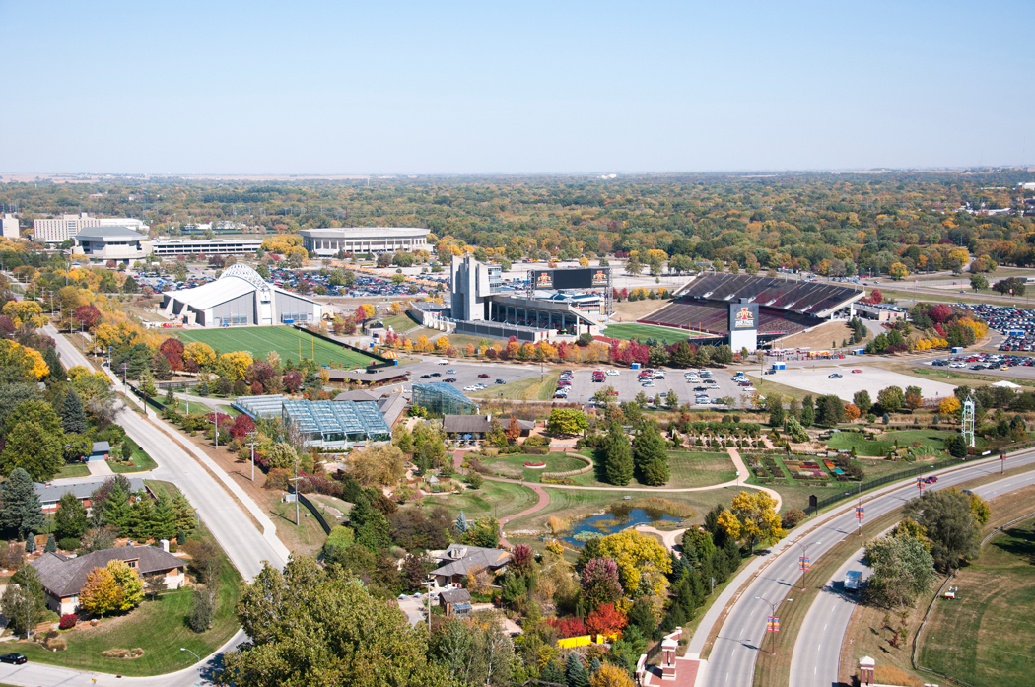
Ames Real Estate
Objective: Optimize investments into mortgage-backed securities by identifying key factors driving home prices in the city of Ames

Slide 2

What are we looking for?
Mortgage holders are more likely to default on a property that drops in price
Undervalued properties are less risky
Overvalued properties are riskier

Slide 3
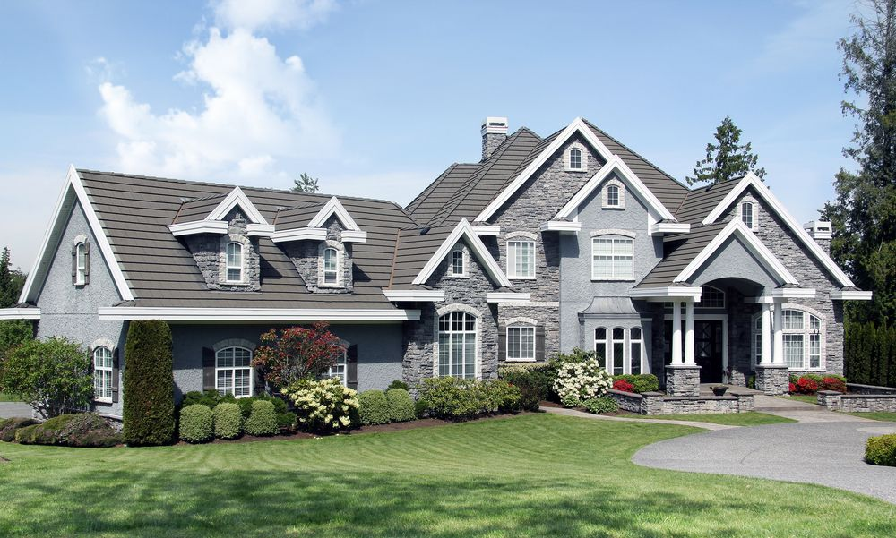
Key Drivers
Property size- larger properties are undervalued due to size
Sale condition- abnormal sale conditions decrease price

Slide 4

The Data
1460 home sales in the city of Ames
Sales from 2006 – 2010
Over 80 data points for each sale

Slide 5
Property Size vs Sales Price
Trend upwards
More SqFt = higher price

Slide 6
Property Size vs Sales Price
Average property size is 13562.7 SqFt
Compared properties above and below the average
Statistically significantly different

Slide 7
Property Size vs Price per SqFt
Trend downwards
More SqFt = lower price per SqFt

Slide 8
Property Size vs Price per SqFt
Compare properties above and below 13562.7
Statistically significantly different
Larger properties have more value per square foot

Slide 9
Sale Condition
Prices vary depending on conditions
Abnormal potential sold under market price

Slide 10
Sale Condition
Compare normal vs abnormal
Abnormal properties are cheaper

Slide 11

Conclusion
Large properties are cheaper per square foot and are safer investments
Abnormal properties sell for below market value and are safer investments

